Slide 1


Welcome to all

Slide 2
GLA UNIVERSITY
DEPARTMENT OF COMPUTER SCIENCE
MINI PROJECT II
ON
TOUR IN INDIA
By
Vedprakash Chaubey ,Nikhil Mishra,Rajan Sharma
Under the guidance of
Md.Farman Sir

Slide 3
Which technology used to make this project
We use HTML (hypertext markup language)
We use CSS (cascading style sheet)
We use PHP (hypertext pre-processor)
We use vs code and sublime text. (source code editor)

Slide 4
PURPOSE
The purpose of this mini - site is to develop a valuable set of information source that provides tourism with information and news about places and current situation about the weather ,climate ,rule of government which should have to follow by the tourism .
This website will also serve as a local as well as for foreigners and give social environment that allows for tourism to discuss and chat about the place related topics.

Slide 5
Tour In India
INTODUCTION :
• India as a tourism destination is the toast of the world at the moment.
• Conde Nast ranked India amongst the top 10 tourist destinations.
• Travel and tourism industry is the second highest foreign exchange earner for India.

Slide 6
SITE MAP
The following site map is proposed .This site map change during the development of the website.
Home page
A web blog
A contact us page.
A detailed site map

Slide 7
How it help the Tourist
It will secure the life.
It will show the right path to the touristers.
Reduce the treacherous.

Slide 8
The number of FTAs in India during:
• 2010: 5.78 million
………...
• 2018: 10.29 million
• 2019: 10.86 million
The number of foreign tourist arrivals in the country in 2020 showed an increase of about 4.1 % over 2010.

Slide 9
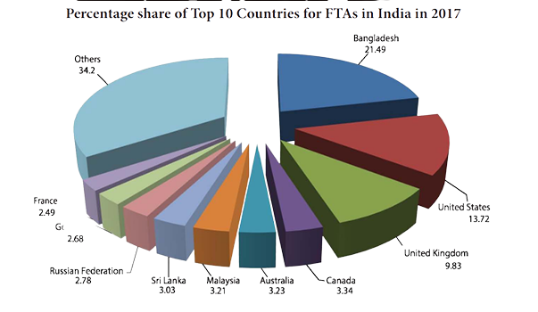
Graph

Slide 10
ADVANTAGE
Direct benefits include economic support for hotels, retail shops, transportation services, entertainment venues and attractions, while indirect benefits include government spending on related infrastructure, plus the domestic spending of Indians employed in the tourism sector.When a lively tourism industry induces the government to invest in national parks and preserves, the environment may benefit.

Slide 11
DISADVANTAGE
Loss of Potential Economic Benefits .
Economic and Employment Distortions .
Inflation and Loss of Amenities for Residents .
Fluctuations in Productivity Index .
Water Pollution .
Air Pollution .
Noise Pollution .
Visual Pollution .

Slide 12
Explore India from Kashmir to Kaniyakumari
ALL
NORTH
CENTRAL
NORTH-EASTERN
SOUTH

Slide 13
Conclusion
We are Sticking to it with our statements and the topic is "Tour in India". we all know like at the starting we discuss about the topic and later we told the how it the help the people and how it will ,demand in market and there are so many advantages of this website.Many othere countries people also visited in our country .we shown it using as a graph.

Slide 14


